Slide 1

THE WEATHER
Radana Bořilová
VY_32_INOVACE_062
ZŠ Jenišovice

Slide 2
THE WEATHER
sun | slunce | wind | vítr
cloud | mrak | spring | jaro
rain | déšť | summer | léto
fog | mlha | autumn | podzim
snow | sníh | winter | zima

Slide 3



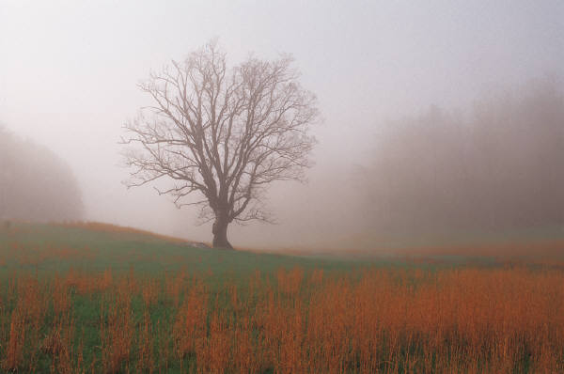
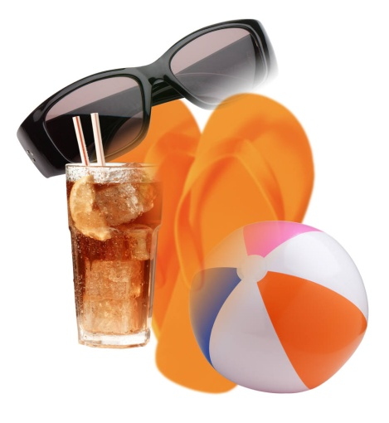

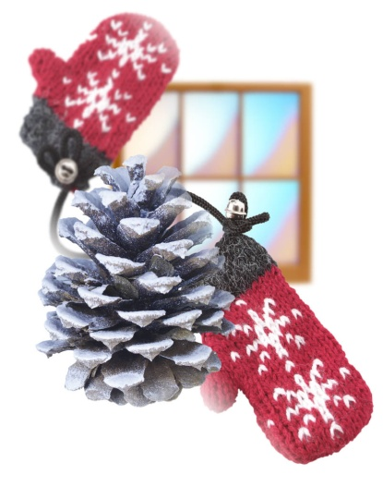
THE WEATHER
snow | summer
winter | cloud
fog | rain
spring | autumn
sun | wind

Slide 4
THE WEATHER
mrak |  | déšť
vítr |  | zima
mlha |  | sníh
podzim |  | slunce
jaro |  | léto

Slide 5
THE WEATHER
summer |  | fog
cloud |  | rain
sun |  | autumn
winter |  | spring
wind |  | snow

