Slide 1

DRINK
Radana Bořilová
VY_32_INOVACE_075
ZŠ Jenišovice

Slide 2
DRINK
milk | mléko
coke | kola
juice | džus
water | voda
tea | čaj
shake | mléčný koktejl

Slide 3
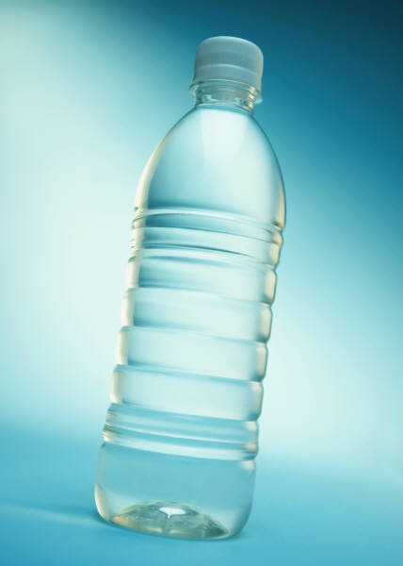
DRINK
water
juice
coke
milk
tea
shake

Slide 4
DRINK

Slide 5
DRINK
coke
tea
water
juice
milk
shake

