Slide 1

FRUIT
Radana Bořilová
VY_32_INOVACE_077
ZŠ Jenišovice

Slide 2
FRUIT
apple | jablko
orange | pomeranč
banana | banán
pear | hruška
plum | švestka
lemon | citrón

Slide 3

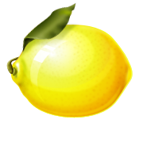
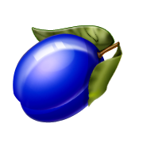
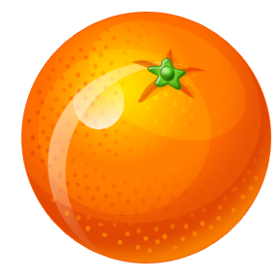
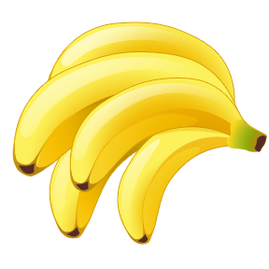
FRUIT
pear
orange
banana
apple
lemon
plum

Slide 4
FRUIT

Slide 5
FRUIT
lemon
orange
plum
banana
apple
pear

