Slide 1

VEGETABLES
Radana Bořilová
VY_32_INOVACE_078
ZŠ Jenišovice

Slide 2
VEGETABLES
carrot | mrkev
tomato | rajče
peas | hrášek
onion | cibule
cucumber | okurka
potato | brambora
pepper | paprika
beans | fazole

Slide 3
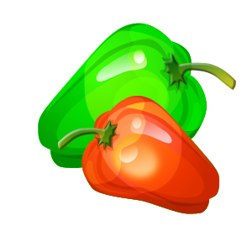

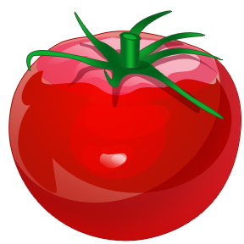
VEGETABLES
peppers
onion
tomato
peas
carrots
beans
cucumber
potatoes

Slide 4
VEGETABLES

Slide 5
VEGETABLES
tomato
beans
carrot
onion
potato
cucumber
peas
pepper

