Slide 1

JACK AND THE BEANSTALK
Radana Bořilová
VY_32_INOVACE_084
ZŠ Jenišovice

Slide 2
JACK AND THE BEANSTALK
hen | slepice
tavern | hostinec
market | trh
sky | obloha
axe | sekyra
harp | harfa
coin | mince
stalk | stonek

Slide 3


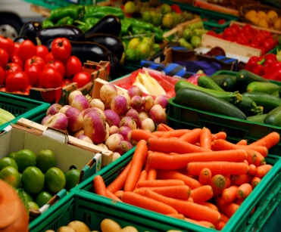

JACK AND THE BEANSTALK
market
axe
tavern
sky
coin
hen
stalk
harp

Slide 4
JACK AND THE BEANSTALK

Slide 5
JACK AND THE BEANSTALK
coin
axe
hen
tavern
market
stalk
sky
harp

