Slide 1

IN THE TOWN
Radana Bořilová
VY_32_INOVACE_086
ZŠ Jenišovice

Slide 2
IN THE TOWN
museum | mazeum | post office | pošta
station | nádraží | cafe | kavárna
shop | obchod | swimmig pool | bazén
church | kostel | restaurant | restaurace
hospital | nemocnice | square | náměstí

Slide 3

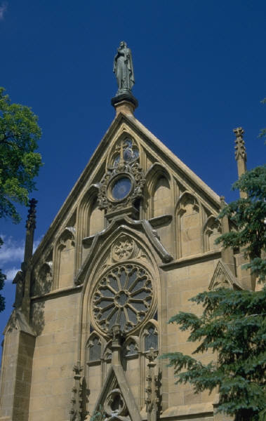
IN THE TOWN
museum | station
shop | restaurant
hospital | church
swimming pool | square
cafe | post office

Slide 4
IN THE TOWN
church |  | shop
square |  | swimming pool
station |  | cafe
post office |  | museum
hospital |  | restaurant

Slide 5
IN THE TOWN
 | nemocnice |  | náměstí
 | nádraží |  | obchod
 | kavárna |  | kostel
 | bazén |  | muzeum
 | pošta |  | restaurace

